Slide 1
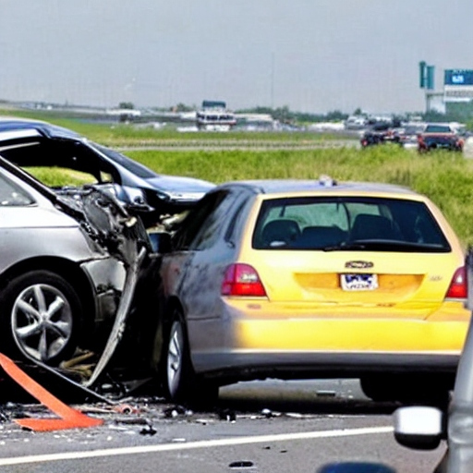
Could the airport be the reason for the car crash?

Slide 2
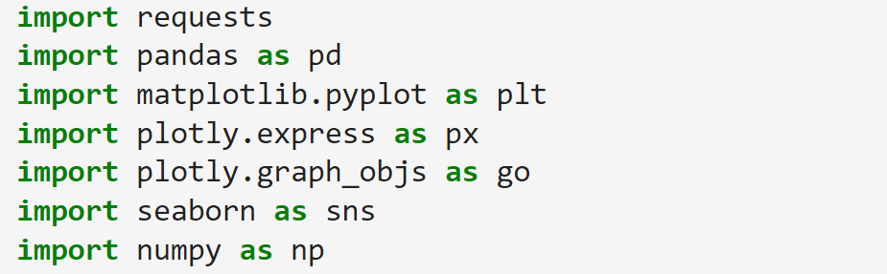
Import necessary libraries

Slide 3
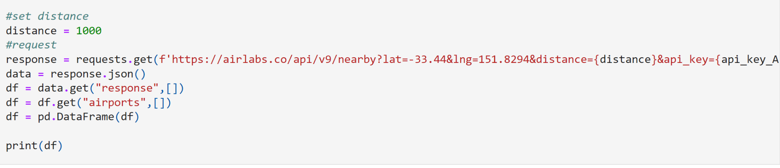
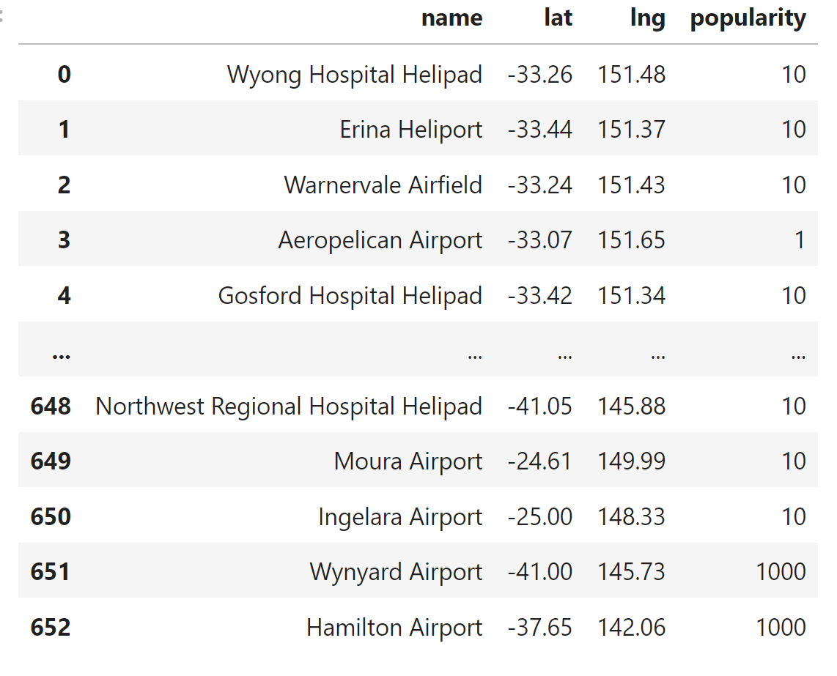
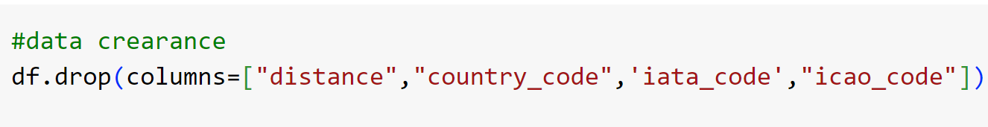
Get data about airports within a distance of 1000 kilometers from Sydney.
Reduce the type of information

Slide 4
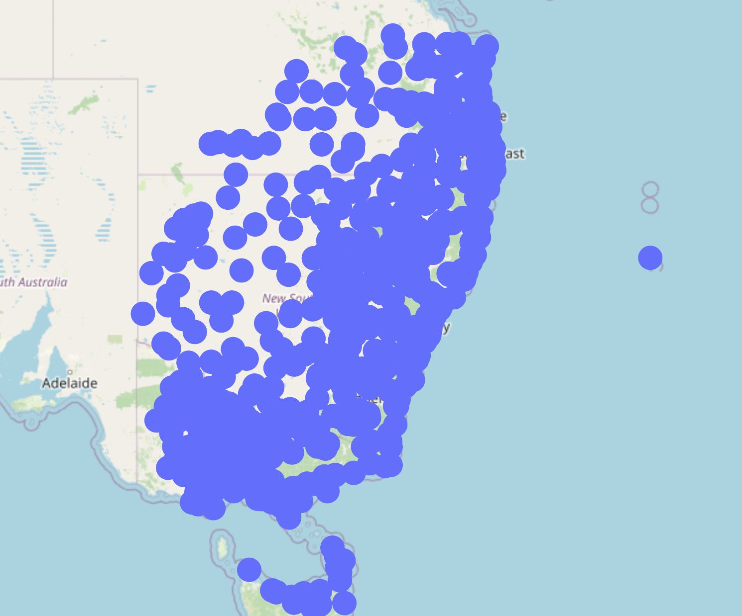
In the map it will look like this
Too much?

Slide 5
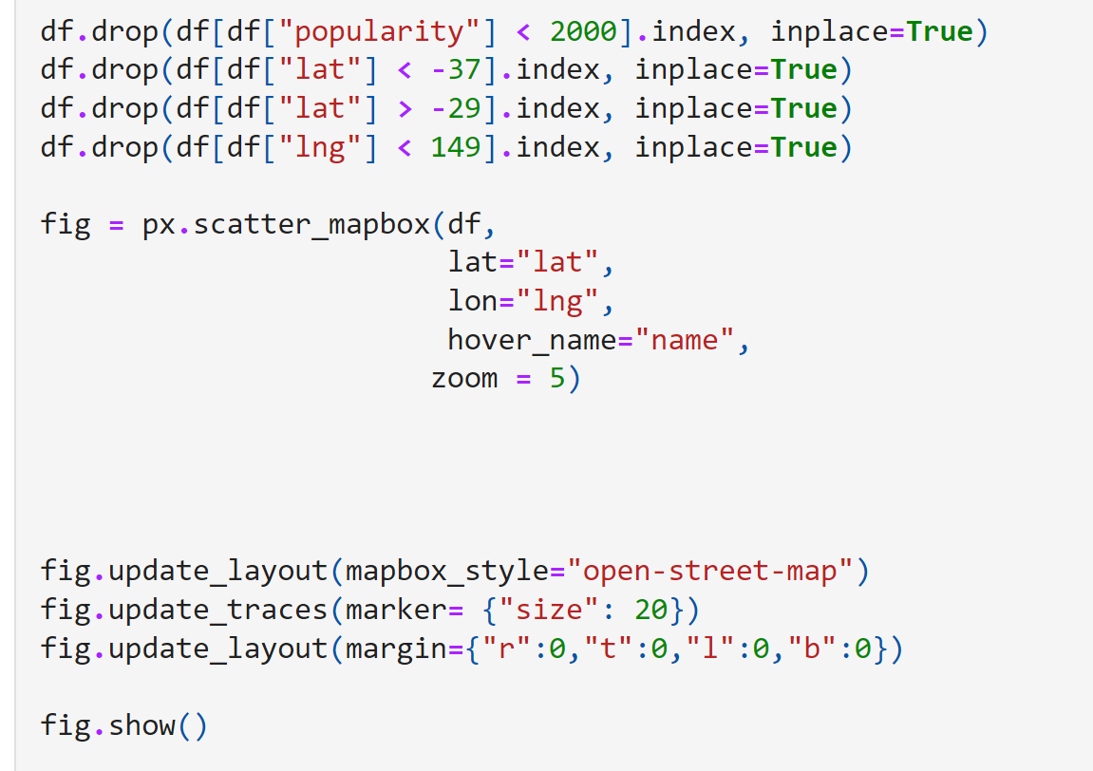
We don't need non-popular airports and airports that are far from the New South Wales area.
We have more than 600 airports, but most of them are small or local helicopter surface.
We need to reduce the number of it
I will separate them by universal label
named “popularity” provided by
DataBase

Slide 6
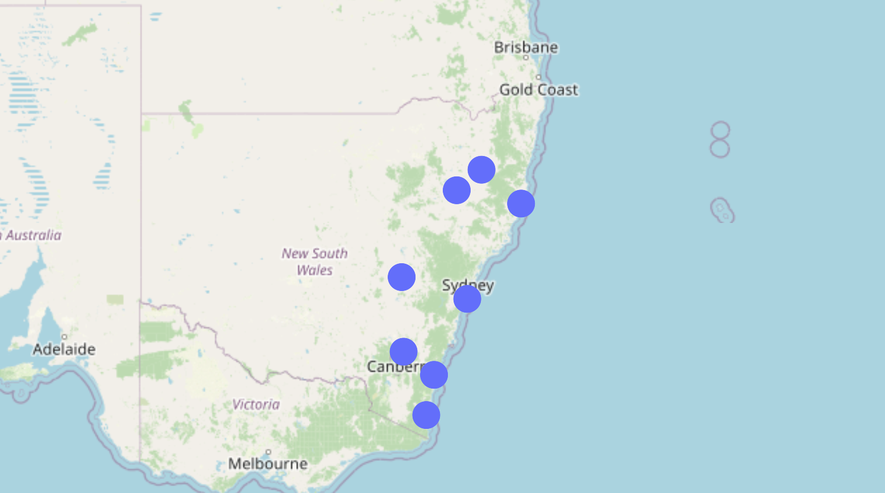
Only popular airports left
Then we should execute non-suitable airports

Slide 7
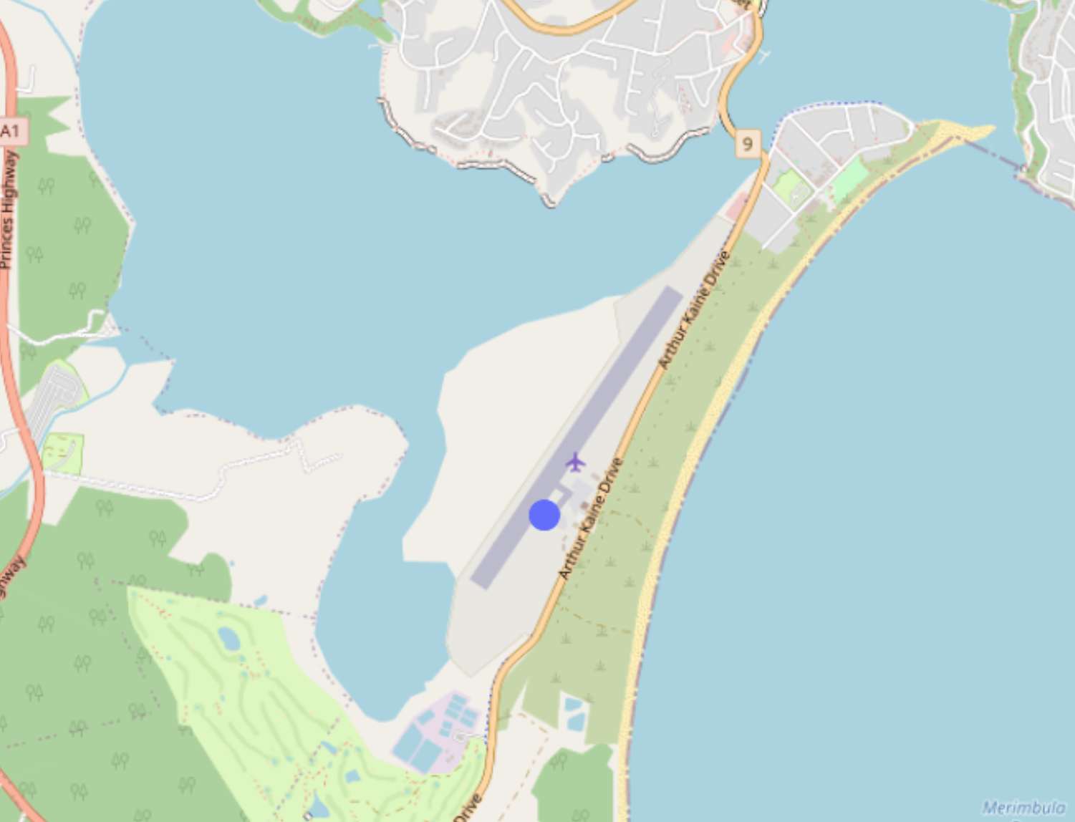
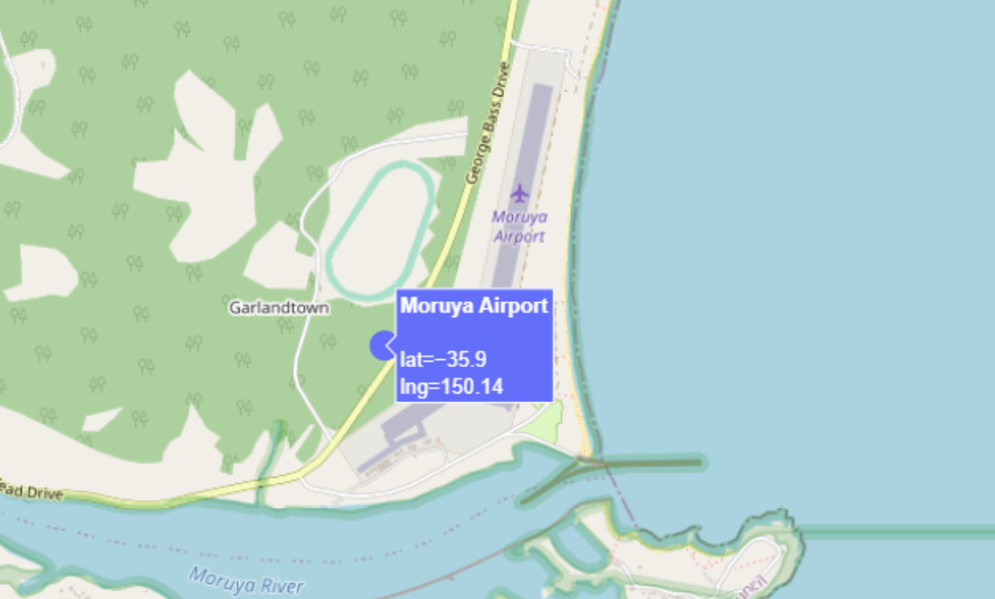
Non-suitable airports example.
There is no any popular road next to them

Slide 8
Getting information about crashes from the Excel file of crashes in New South Wales
In that file 95k cases of car crashes and 49 types of information .

Slide 9
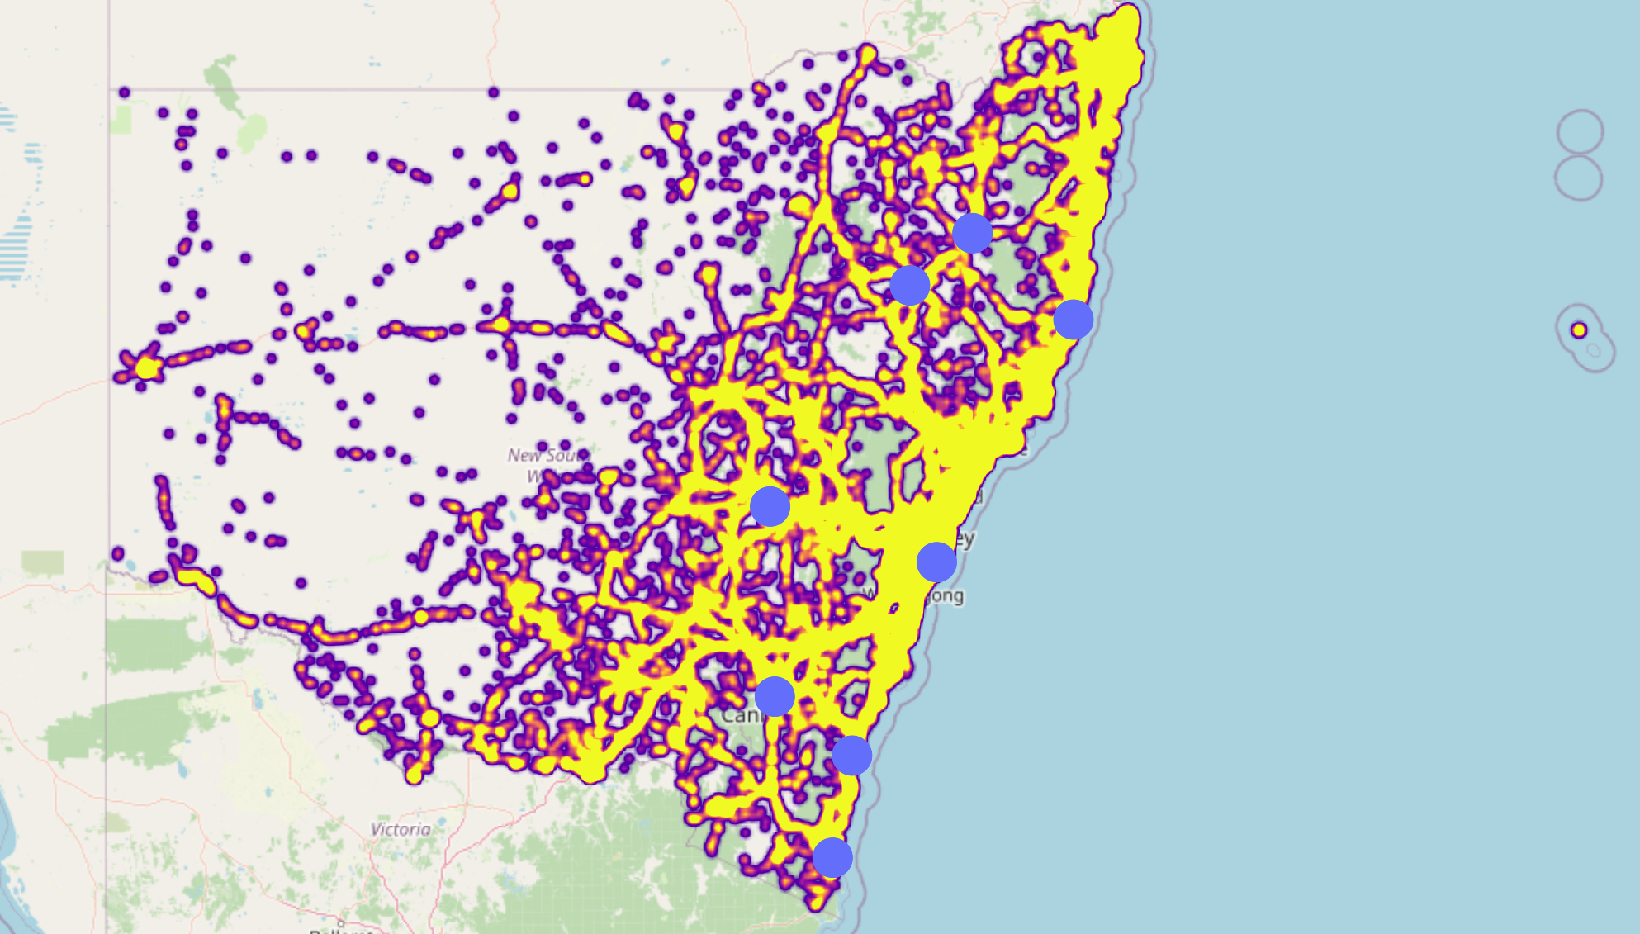
The heatmap of of the crashes

Slide 10
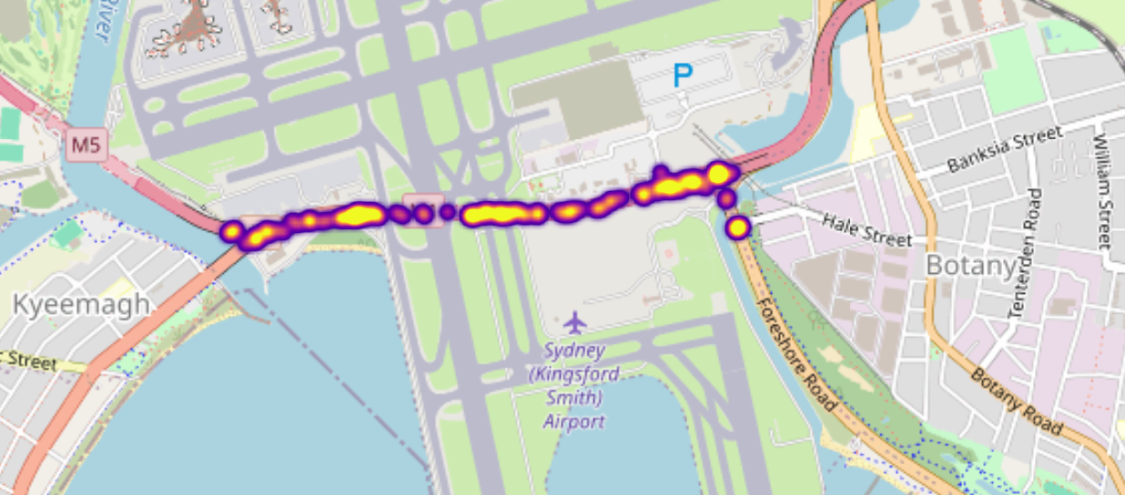
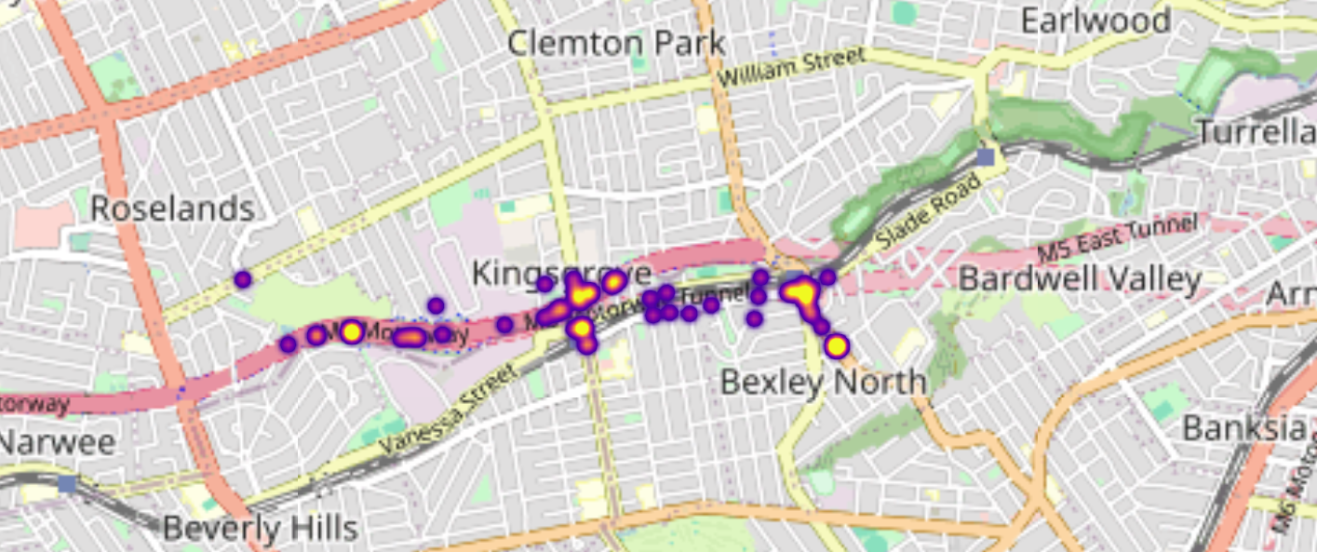
I decided to choose 2 zones to analyze how airport affect to drivers

Slide 11
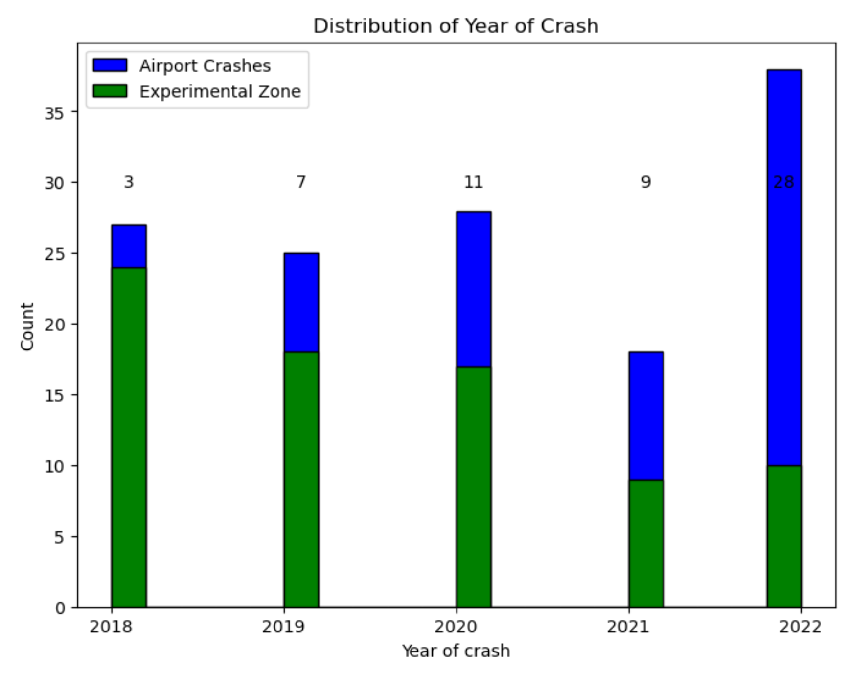
Comparison visualization

Slide 12
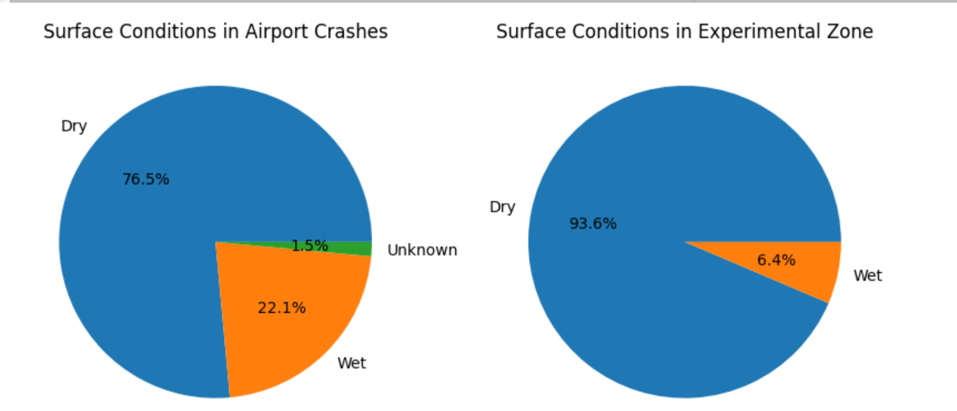

Slide 13
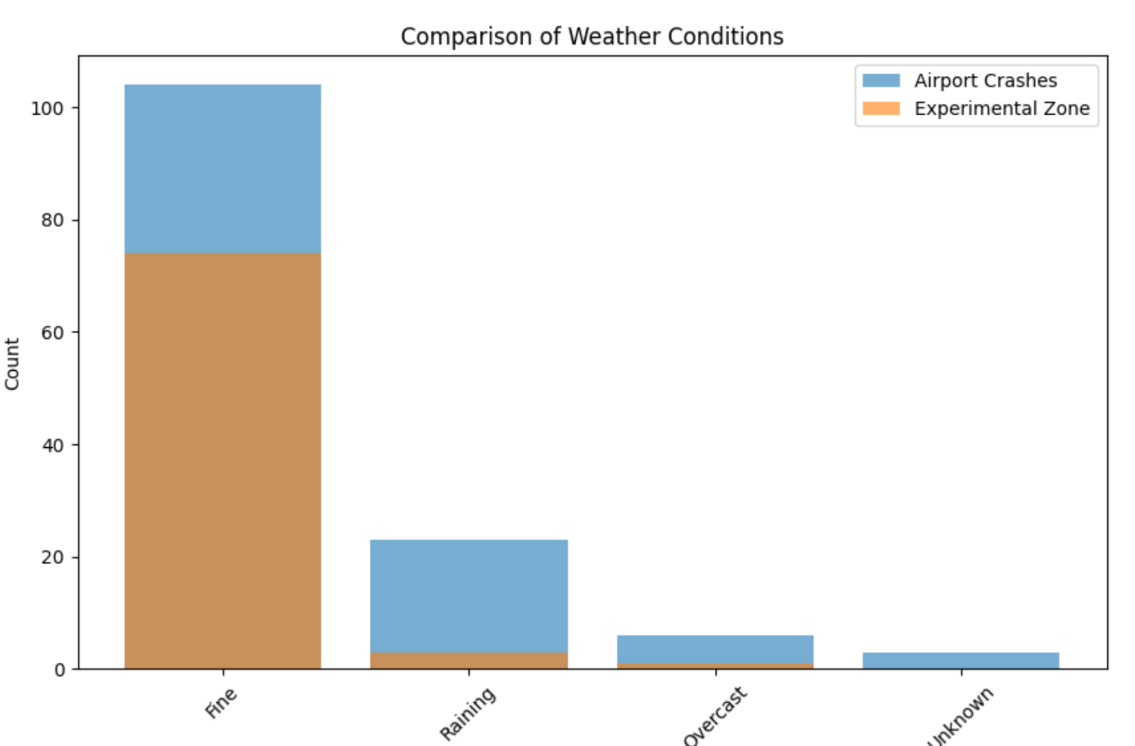

Slide 14
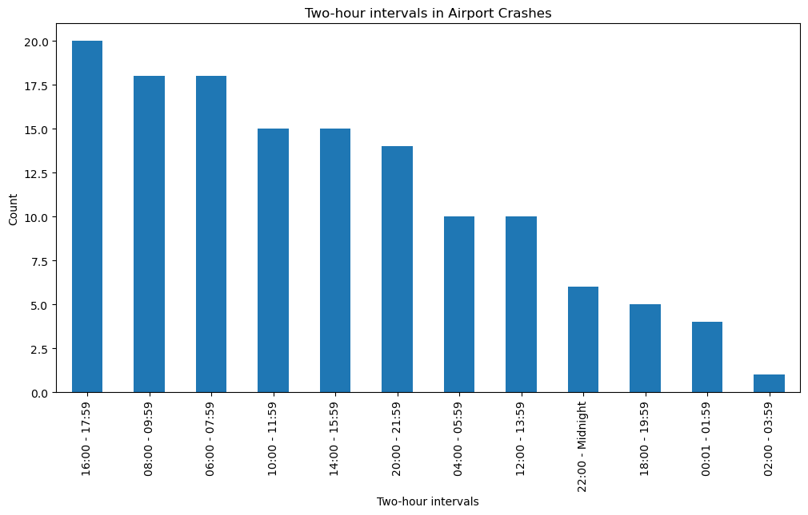

Slide 15
